Slide 1
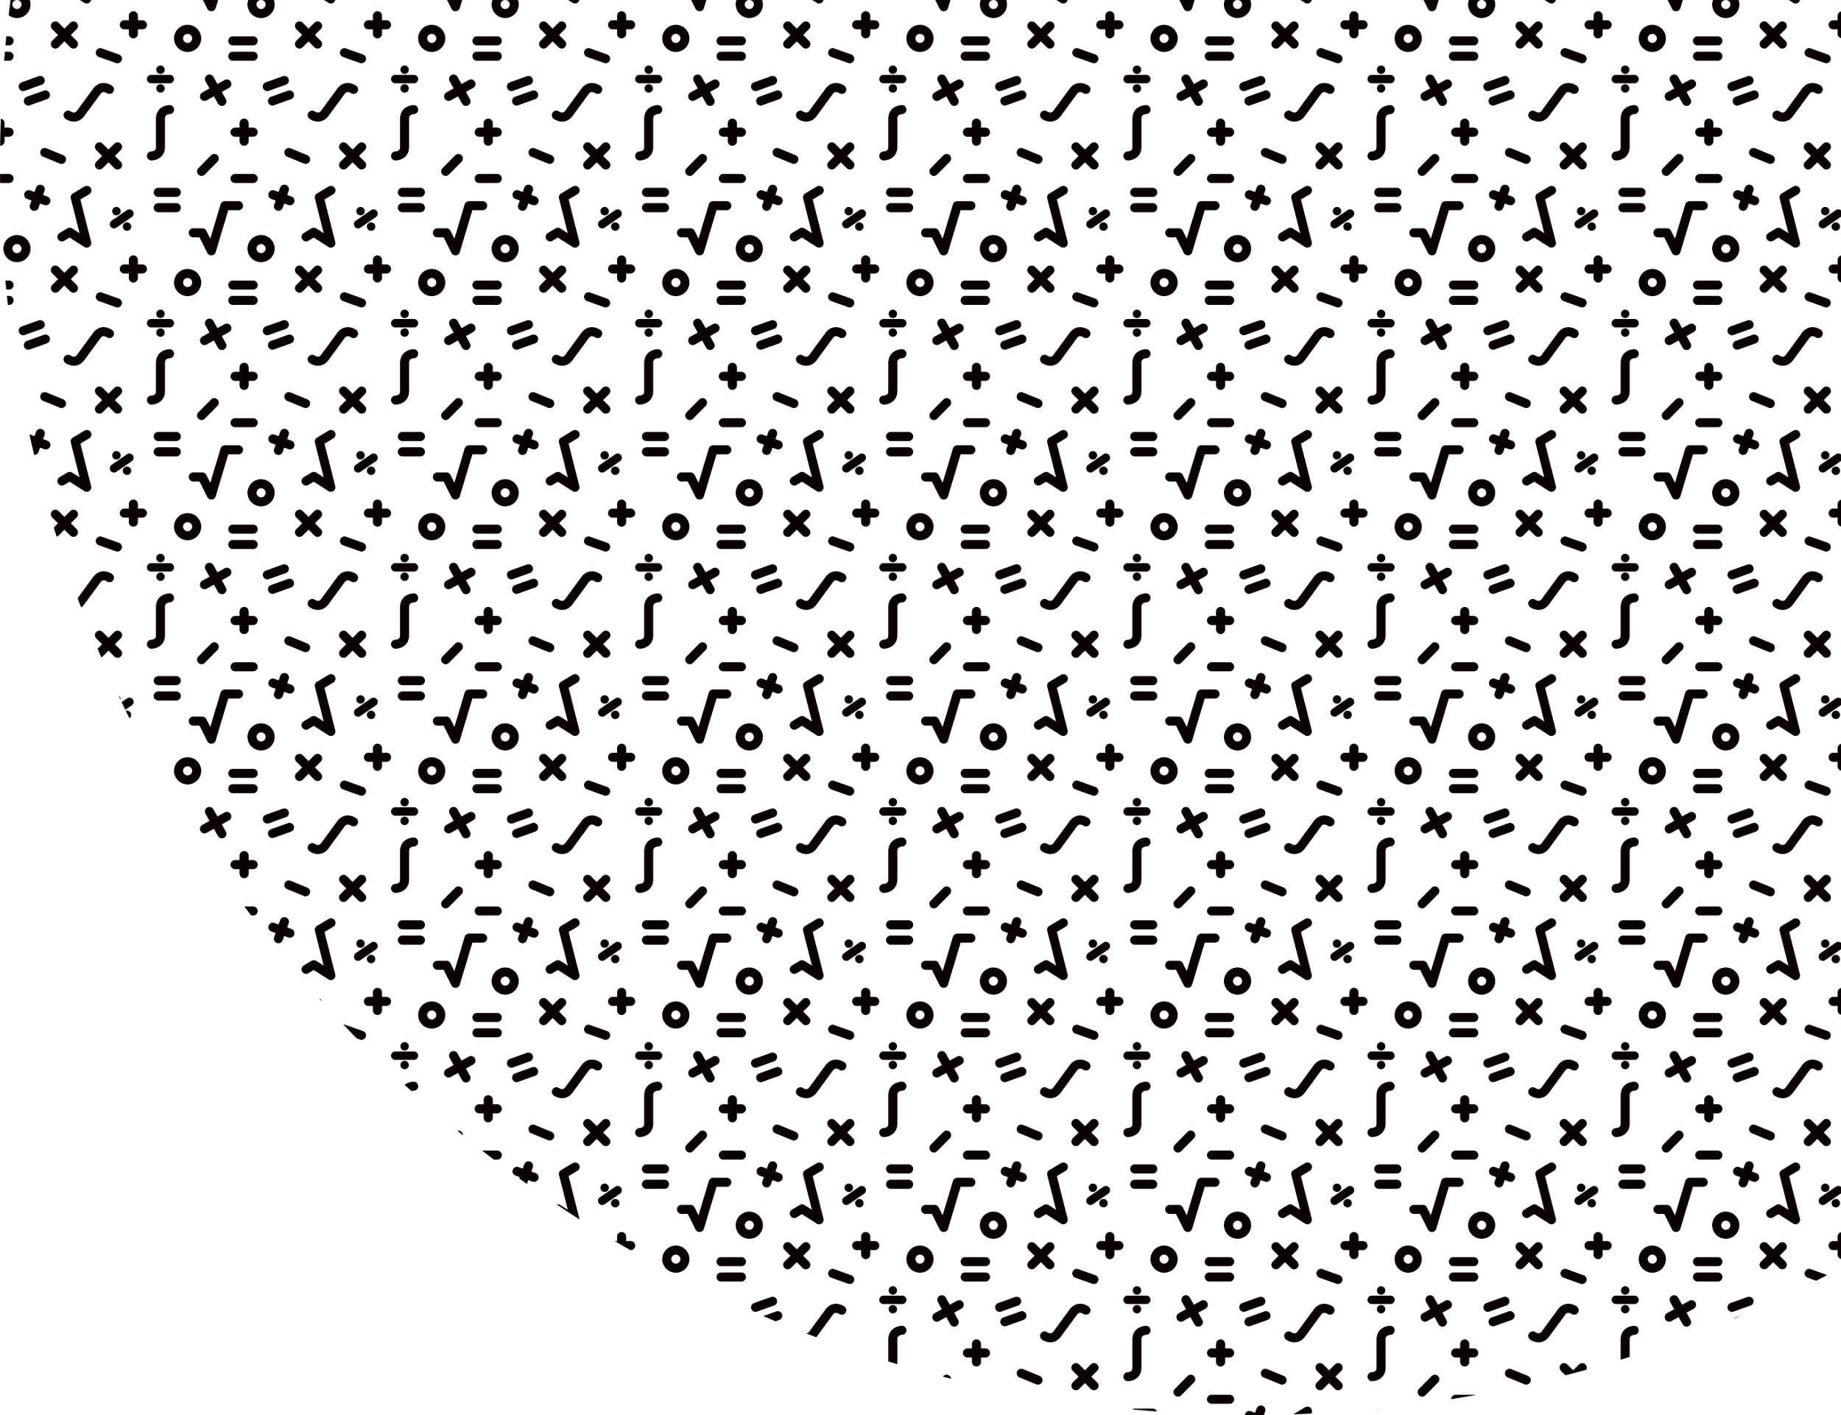


Niko Mađar
Testing machine learning systems
Infinum Talks: Machine learning and test cases, 2022

Slide 2
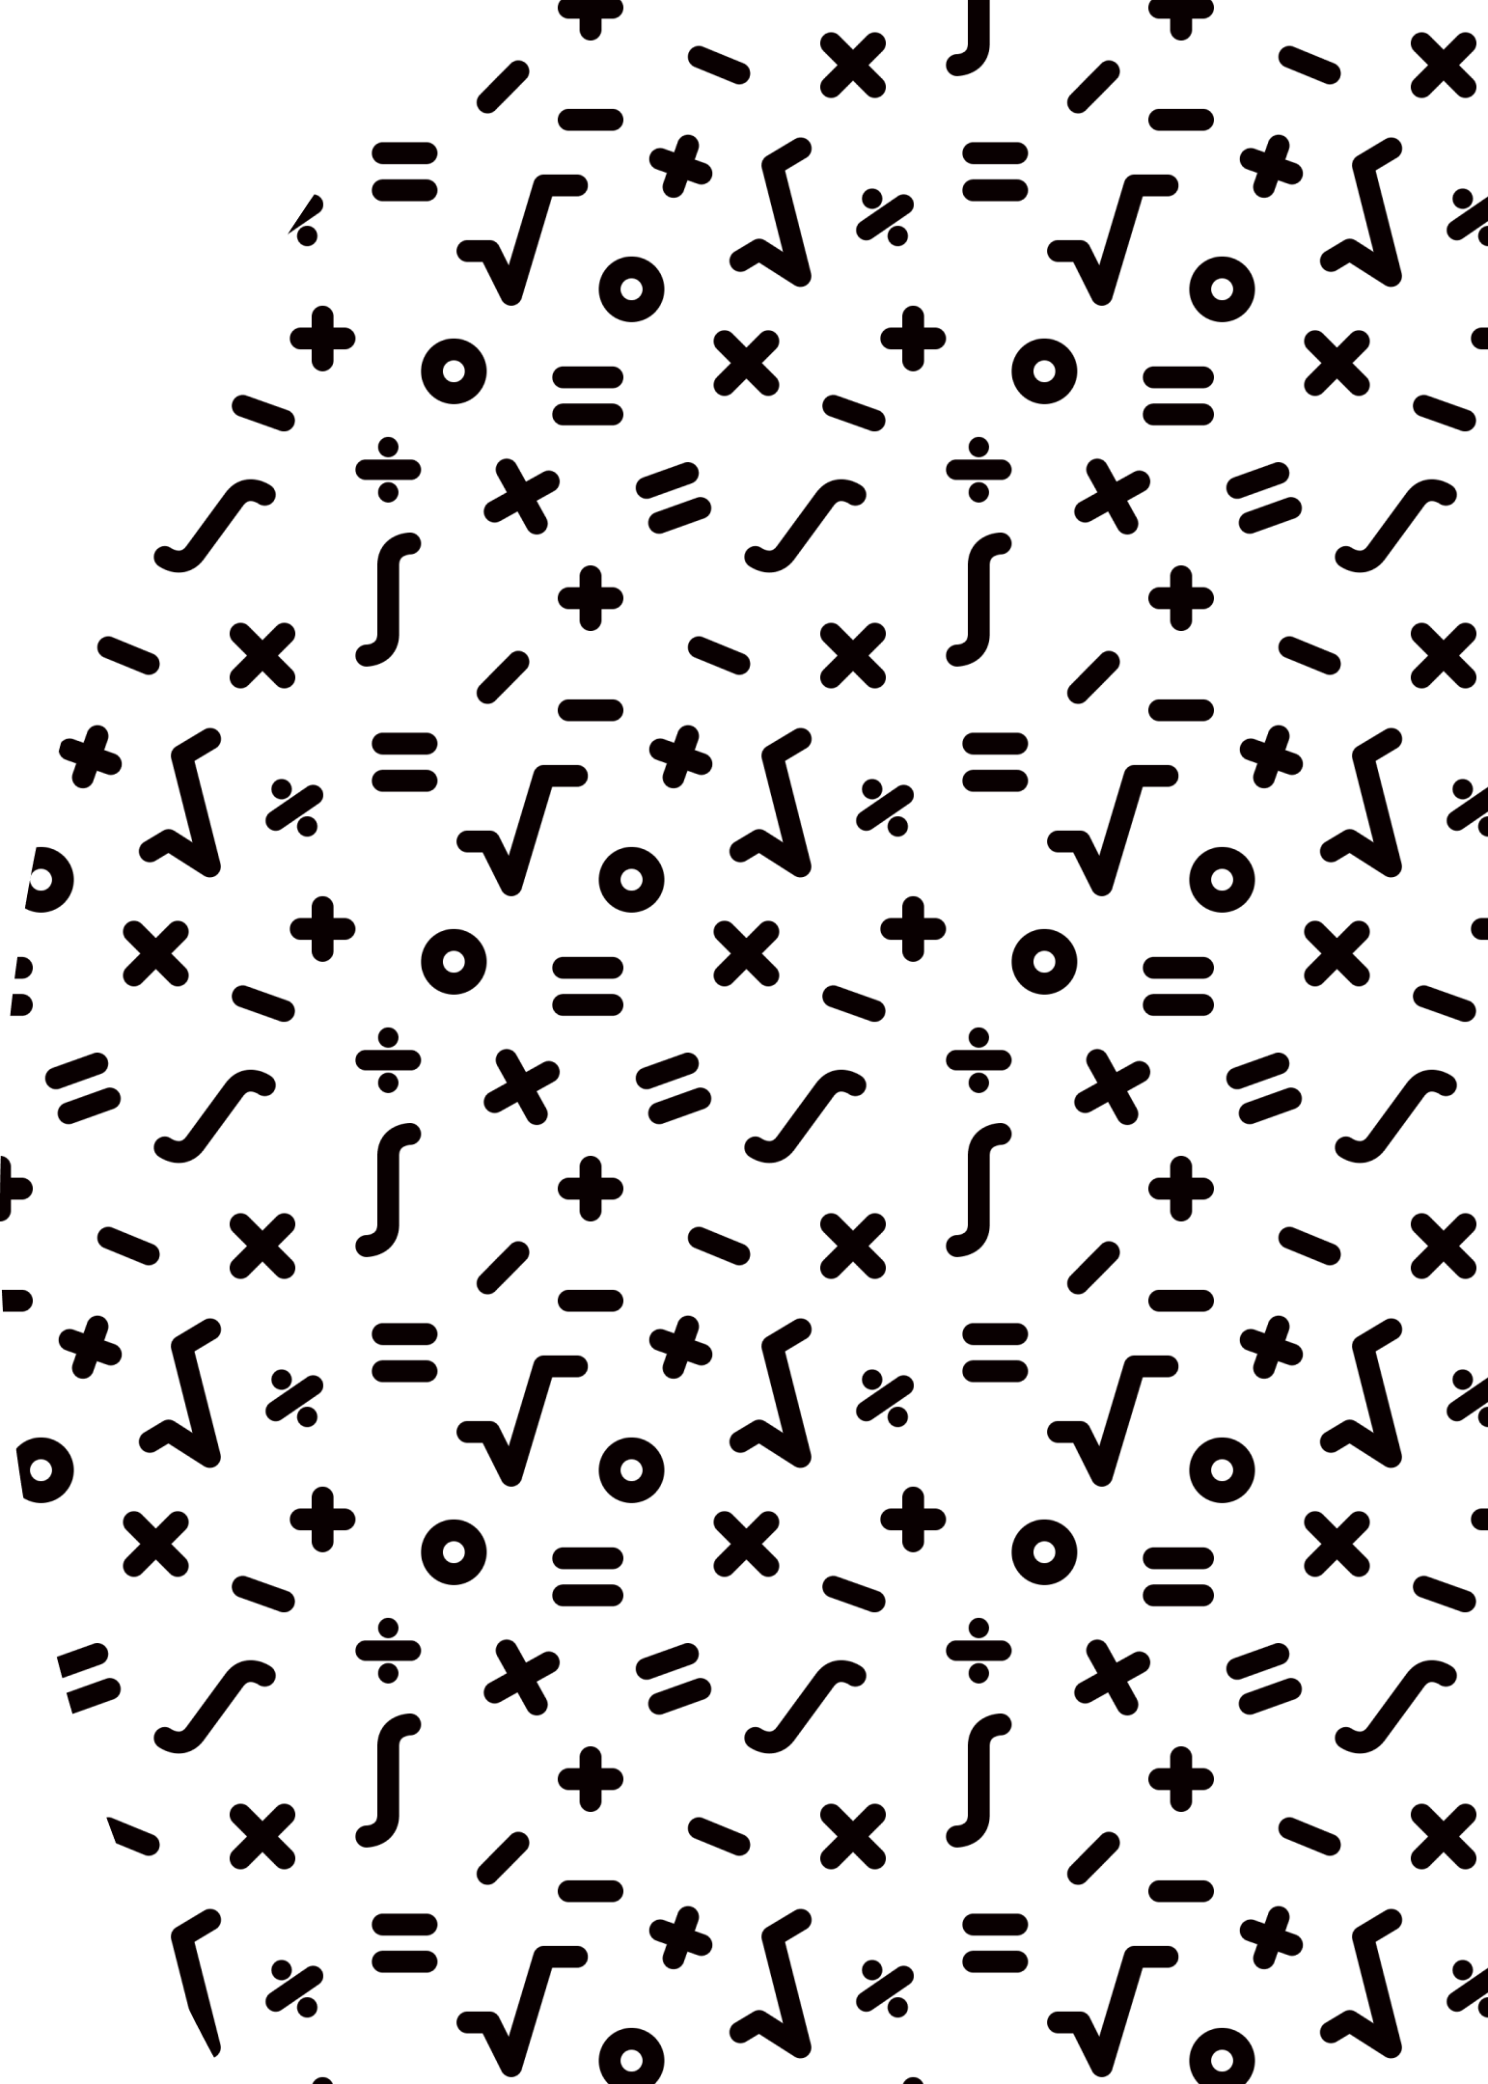

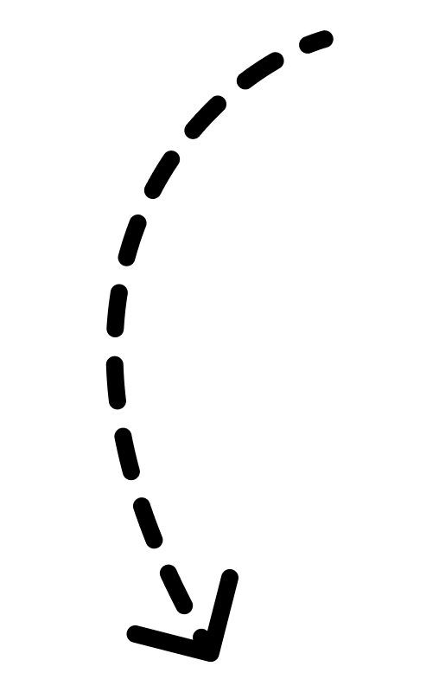
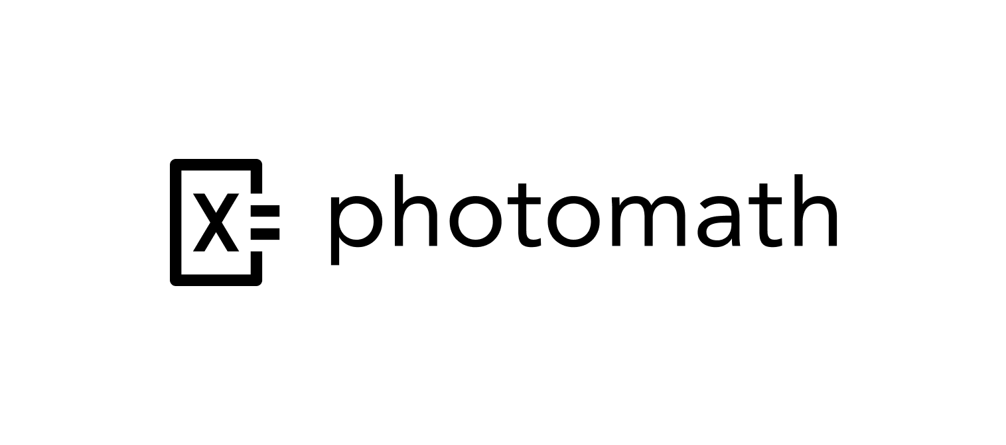
About me
Senior Quality Assurance Automation Engineer @Photomath
Organizer of the Testival Zagreb Meetup and Testival Conference

Slide 3
Agenda
What are neural networks
How do neural networks work
Types of neural networks
Usages of neural networks
Testing neural networks

Slide 4
MATHS AHEAD!

Slide 5
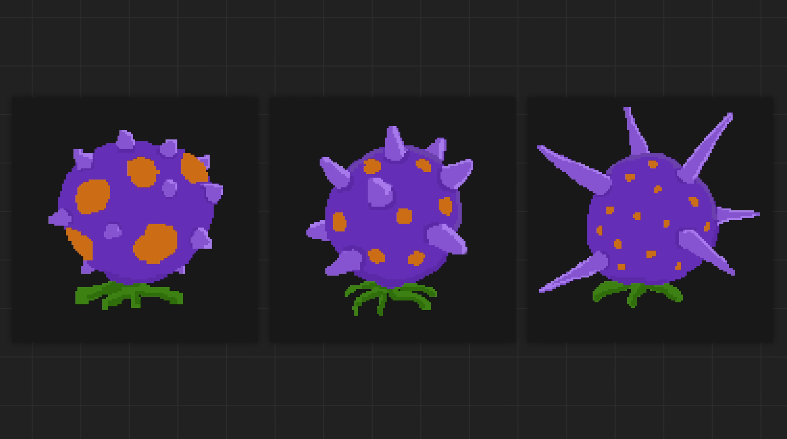
Notes:
We’ll use a simple example to explain how neural networks work.
Let’s take a fruit with spots and spikes, and let’s say that the variation in spots and spikes determines if the fruit is safe or poisonous.

Slide 6
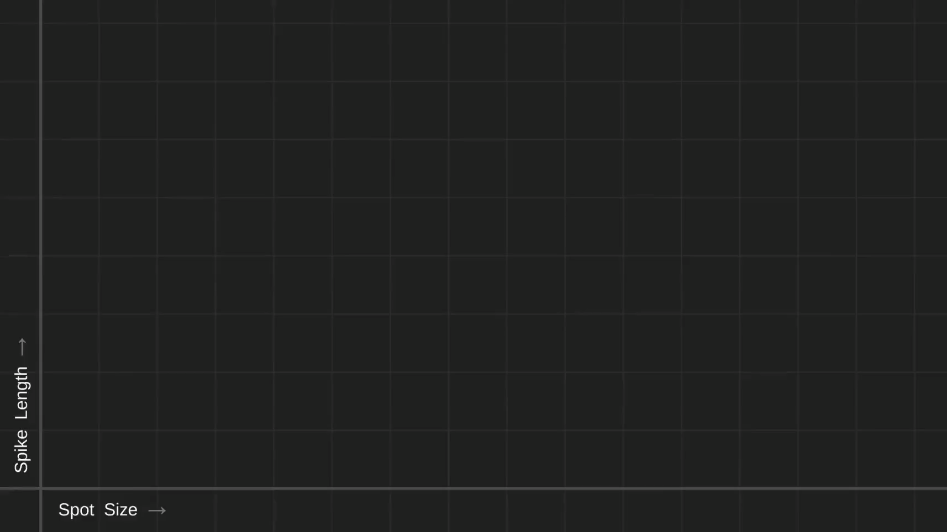
source: youtube.com/c/SebastianLague
Notes:
We can visualise the distribution of spike length and spot size in a graph and mark the ones that are safe.
However, if the distribution is random, it means our original hypothesis that the spikes and spots are linked to poison is false.
But In the case, it is we can see a pattern where certain values determine that a fruit is safe.

Slide 7
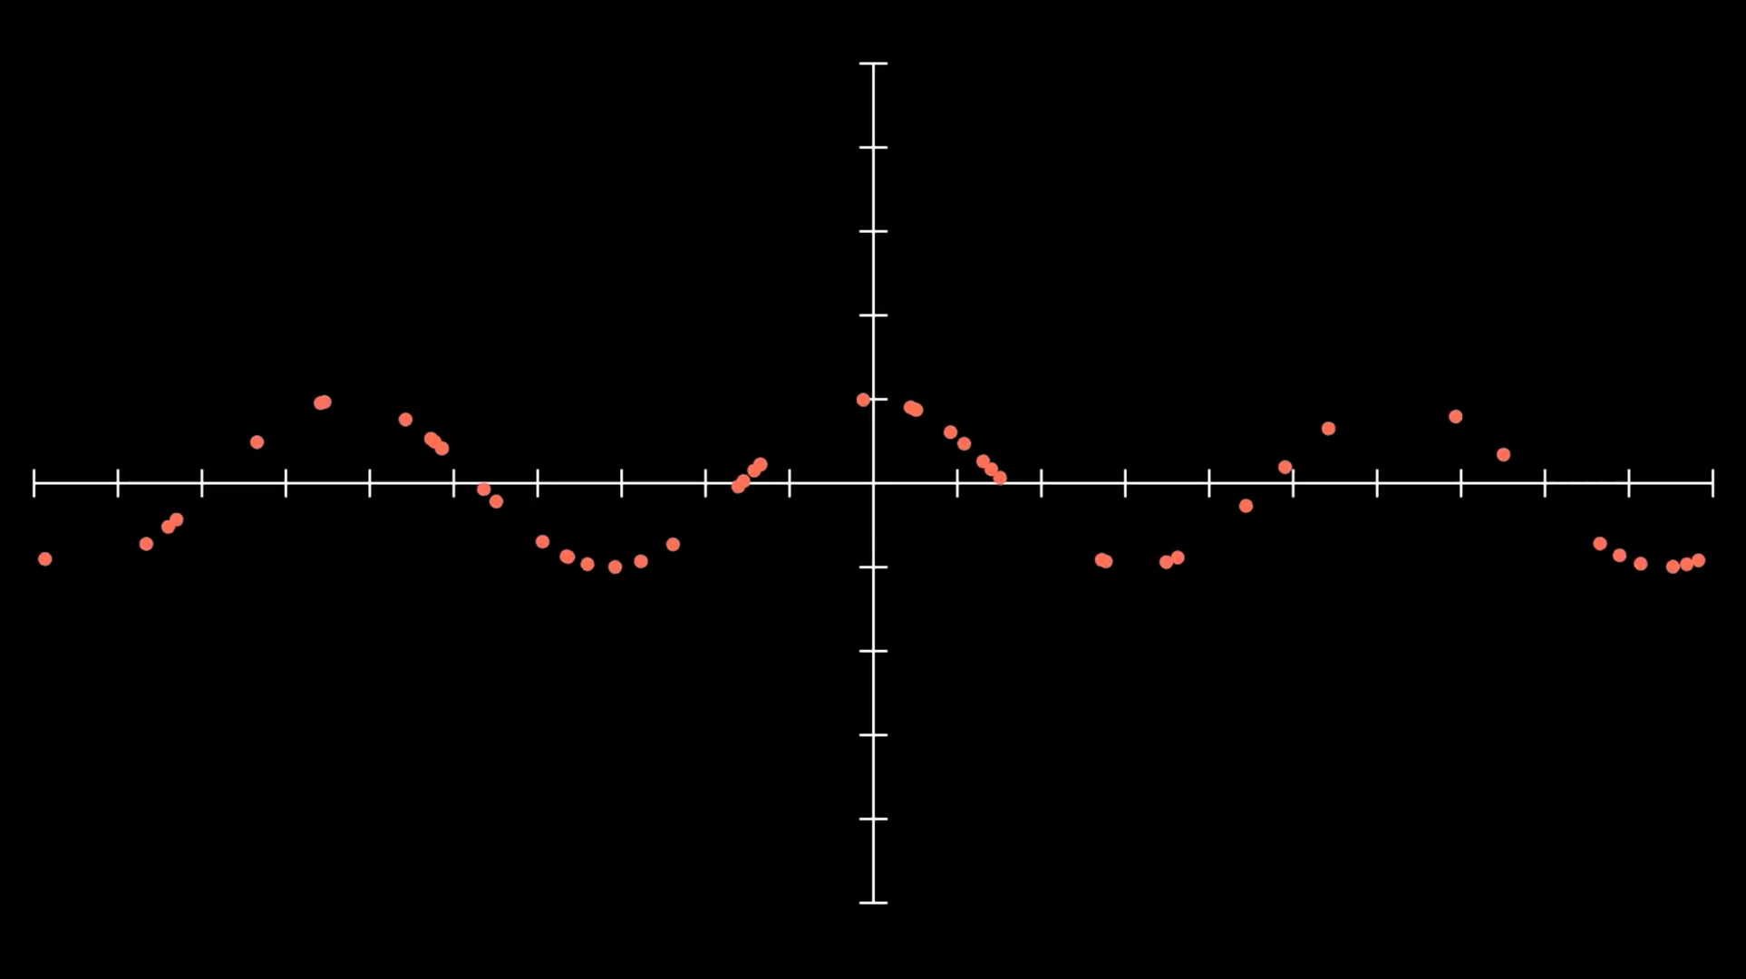
source: youtube.com/c/EmergentGarden
source: youtube.com/c/SebastianLague
Notes:
Now, these are certainly not all possible variations but we can infer the general rule by the dataset we have and set some boundaries.
Neural networks are general function approximators. This means that they can approximate any function given enough data.
Like in this example, we have points on our graph but we don’t know what the function is.
We can, however, determine the function that these points belong to by creating a neural network and make it learn the pattern.
We get the original function in the end.
Even if our data has some randomness we are still able to approximate the originat function pretty accurately

Slide 8

source: youtube.com/c/SebastianLague
Notes:
Lets construct out neural network.
We have two inputs: spikes and spots
And we have two outputs: safe or poisonous
We connect the inputs with the outputs and we assign a weight to each connection.
Then we sum up the connections for a given output and we get the calculation of how that input affects the output.
The weights will determine how much an input affects the output

Slide 9
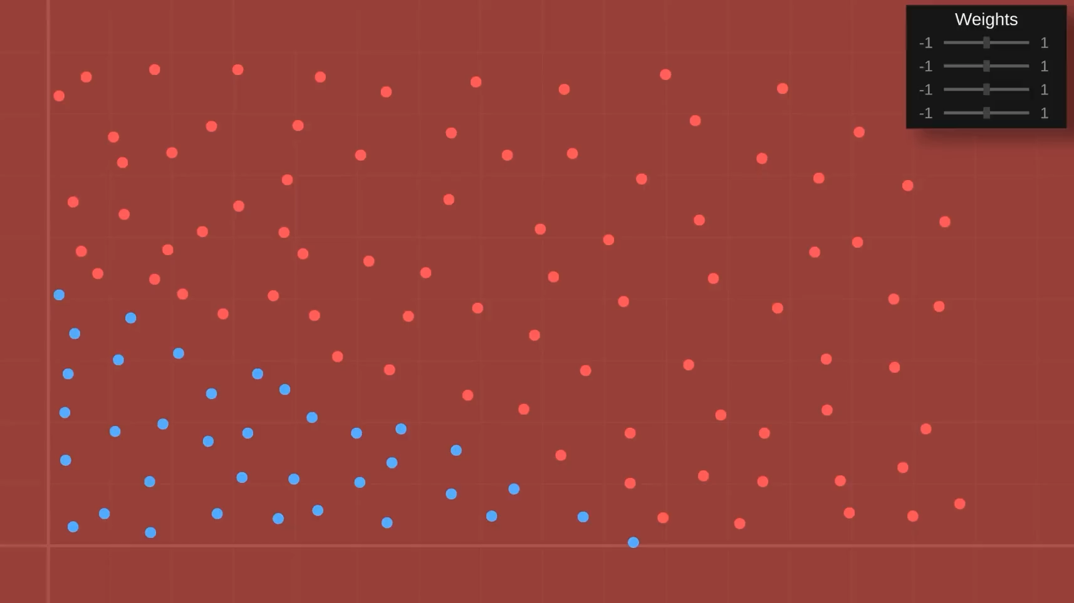
source: youtube.com/c/SebastianLague
Notes:
We can now play with the weights and see what happens to our approximation function
As we can see, we cannot move away from the origin, we can only rotate around it.
That’s because our function is a simple y=nx
In order to move our linear function above or below the origin, we need to add something

Slide 10
output1 = input1 * weight1.1 + bias1
Notes:
We can add a bias that will enable us to translate our function around the origin

Slide 11
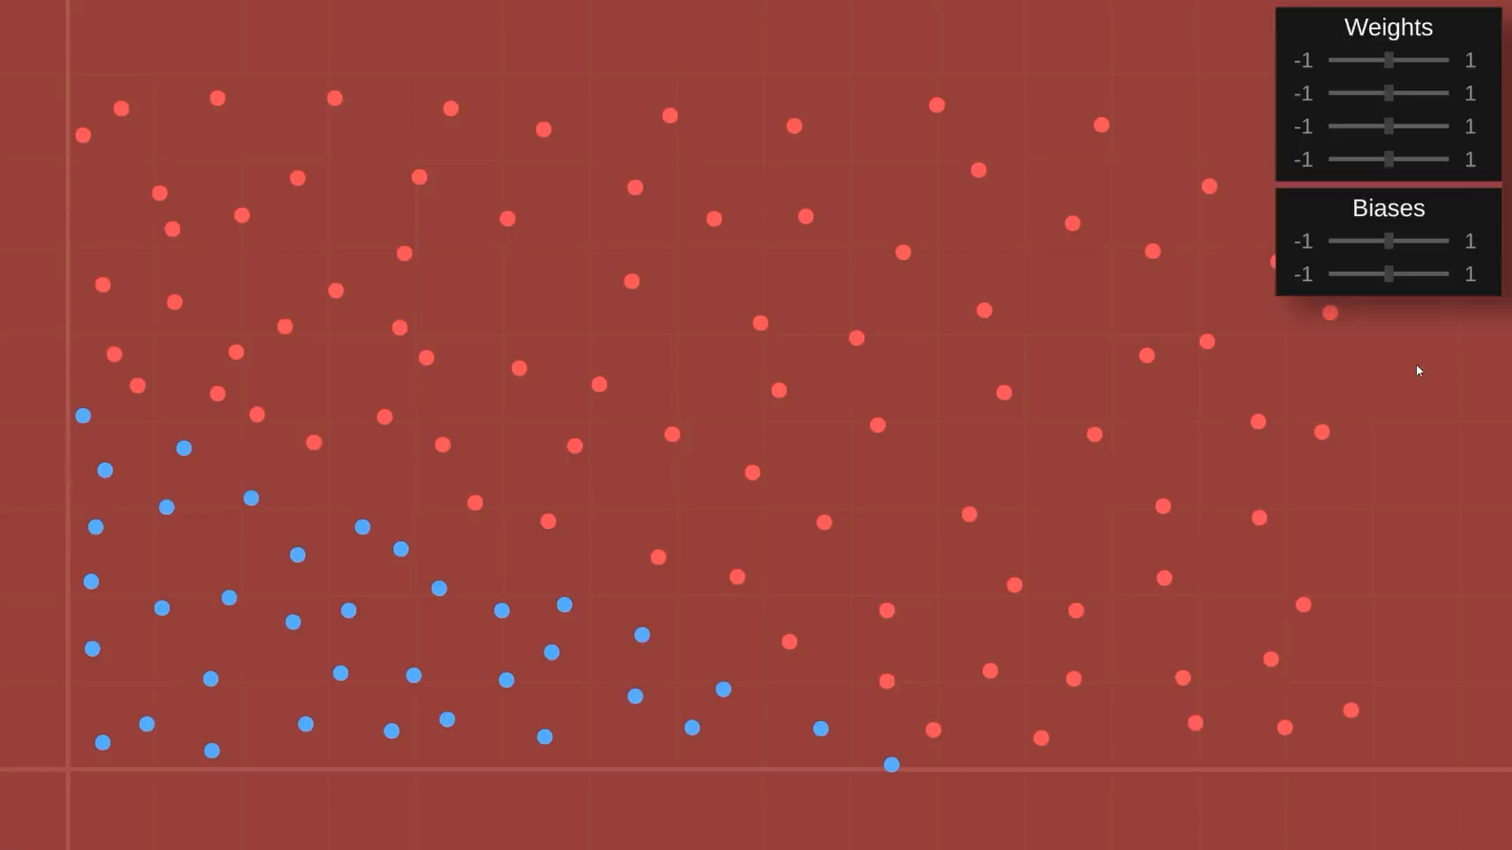
source: youtube.com/c/SebastianLague
Notes:
Now we are able to translate the function and can actually determine a function that gives us a good approximation of the function for calculating which food is safe and which is poisonous

Slide 12
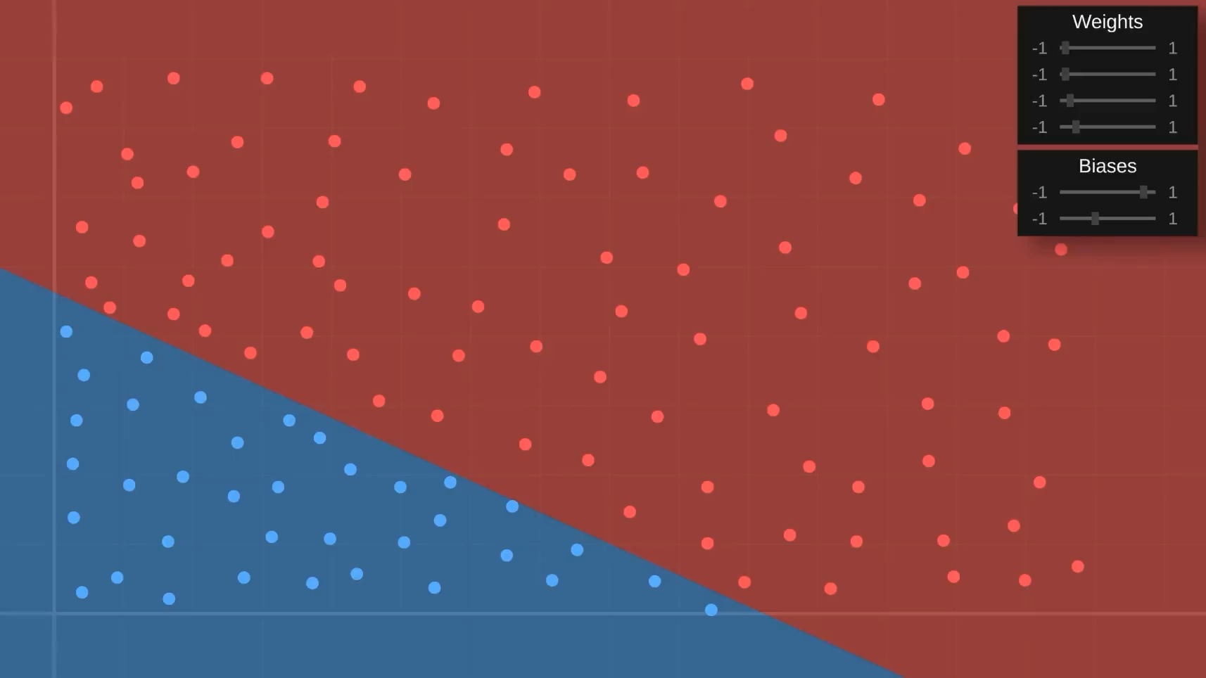
source: youtube.com/c/SebastianLague
Notes:
However, what if our data is not so simplistic and we have a different distribution

Slide 13
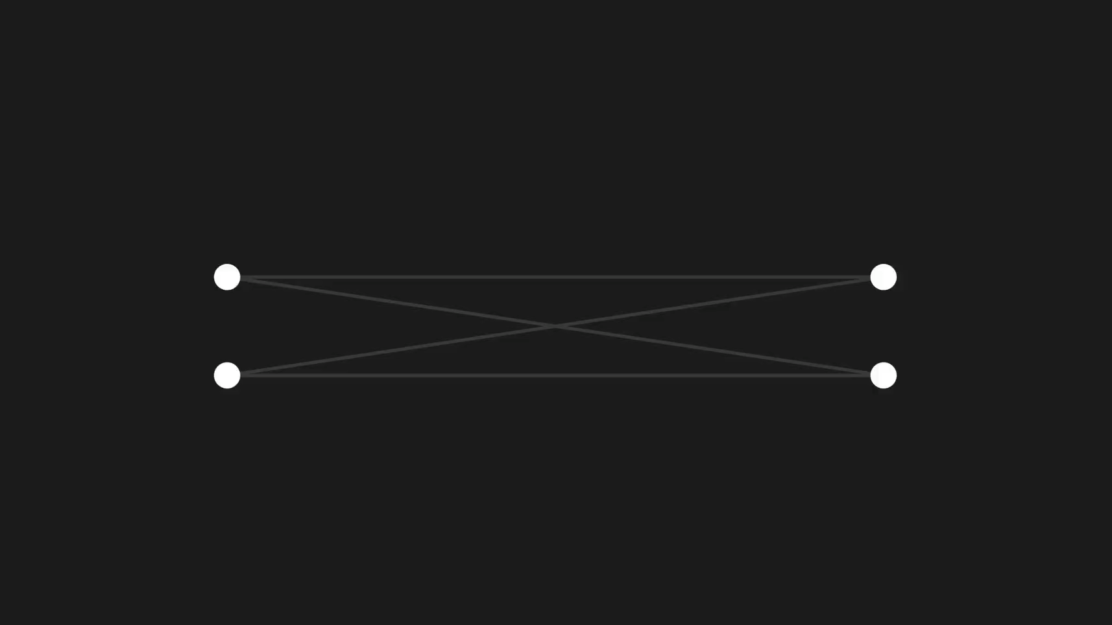
source: youtube.com/c/SebastianLague
Notes:
Lets try adding a new layer to our neural networks so that we can have more weights and biases to influence the function

Slide 14
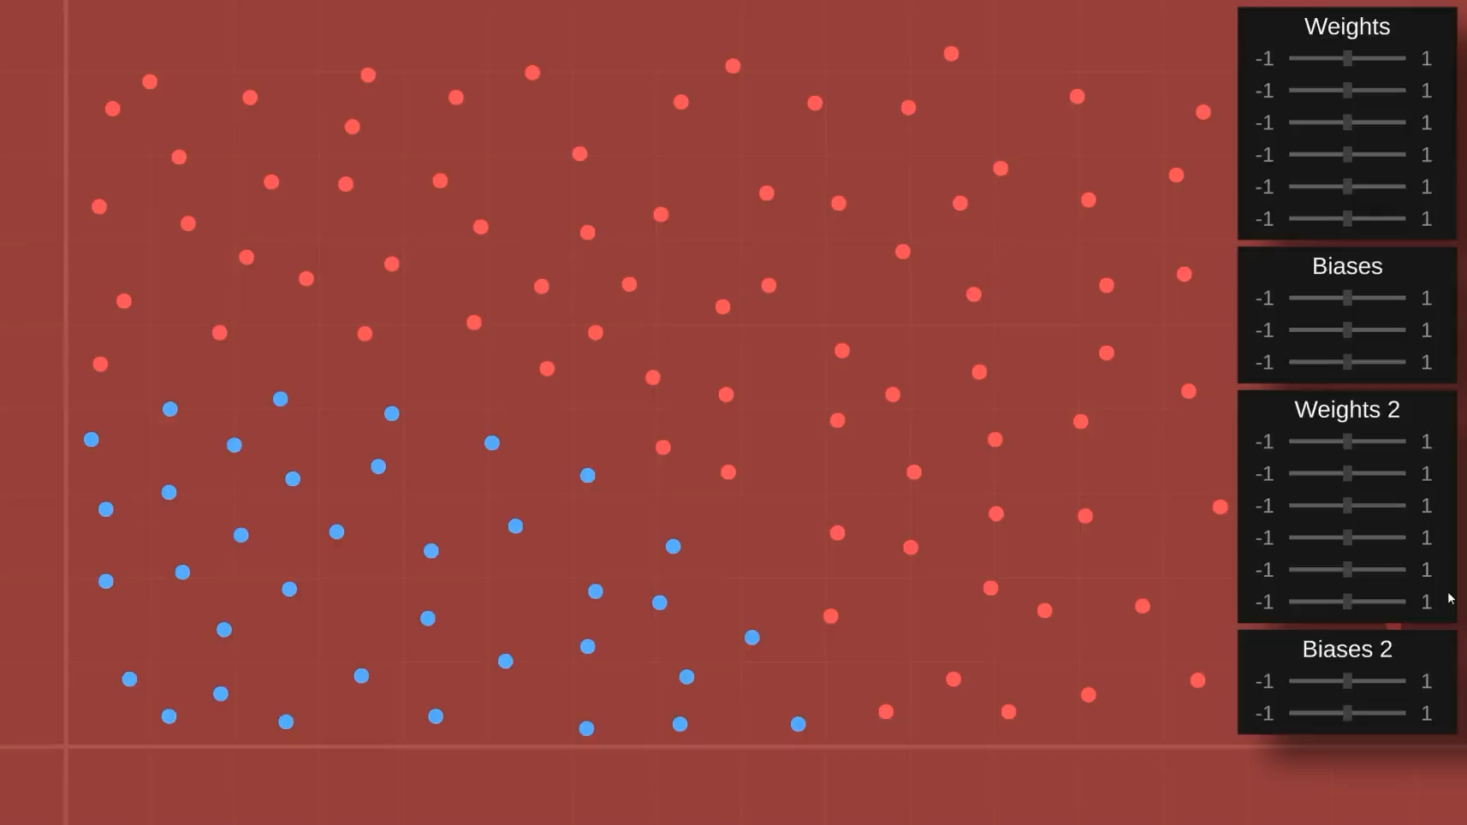
source: youtube.com/c/SebastianLague
Notes:
Our function is still just linear.
Which means we can only manipulate a line.
To fix this we need to add a non linear transformation/function to enable to perform manipulations that are not just a straight line.

Slide 15
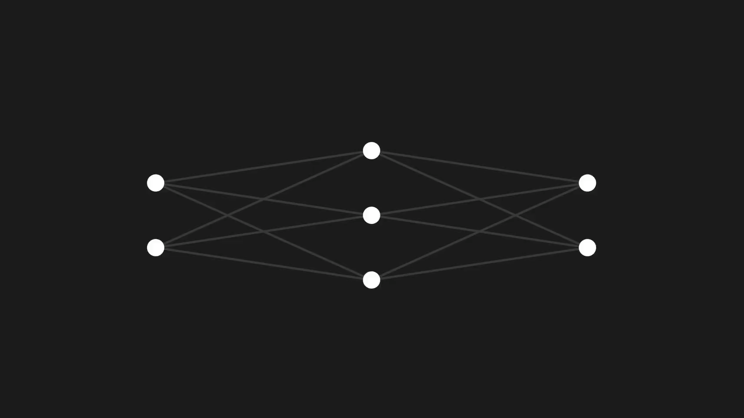
source: youtube.com/c/SebastianLague
Notes:
We accomplish this by adding an activation function.
An activation function takes the value and applies a function to it to modify the result.
It is called an activation function because it is similar to how neurons work in biology.
They fire when the threshold of sensory input is above a certain value. In other words: hey activate at certain values.
This will make our function non-linear and enable us to approximate different shapes

Slide 16
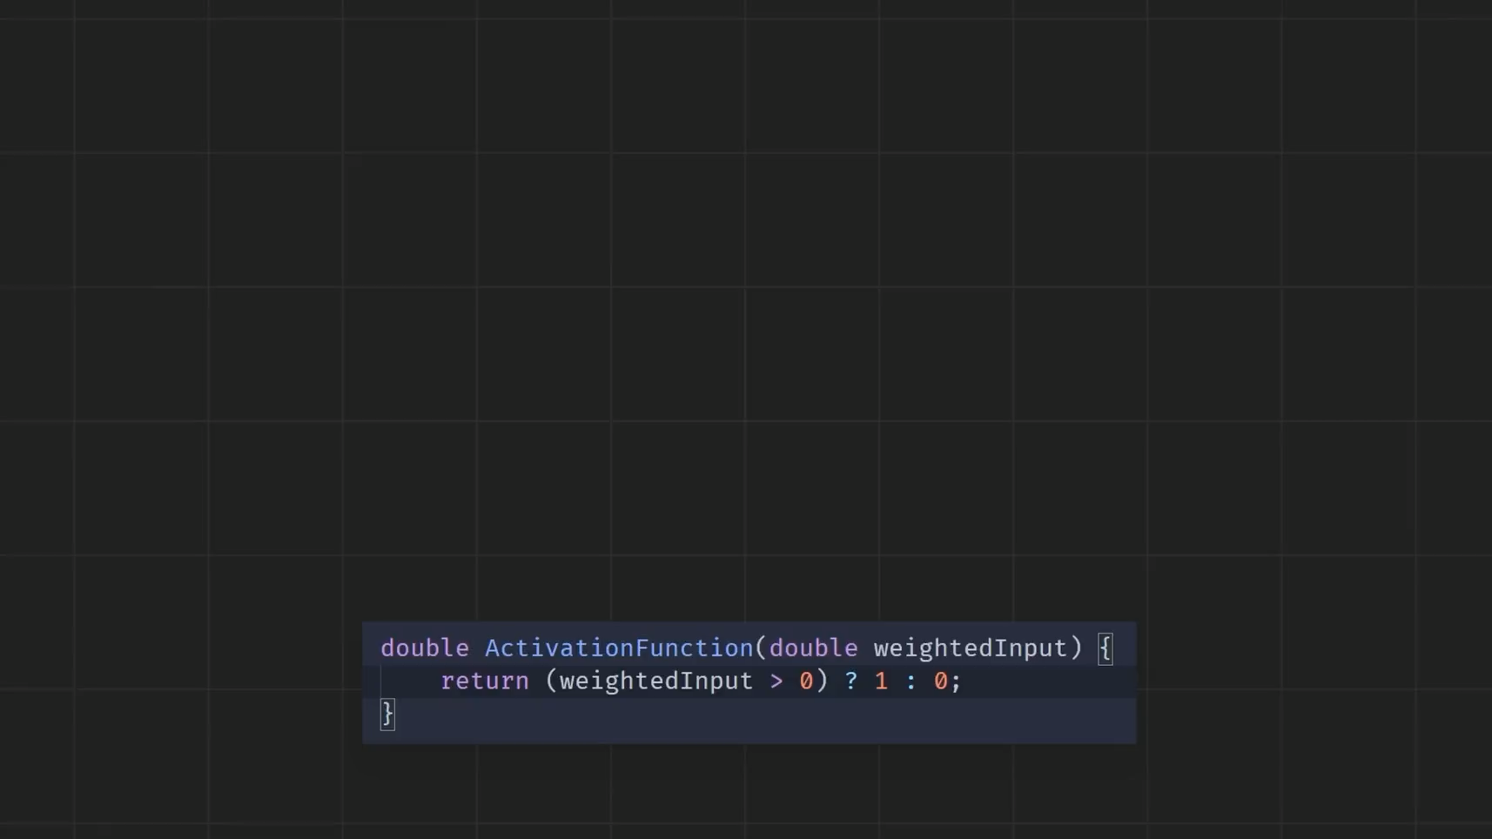
source: youtube.com/c/SebastianLague
Notes:
The simples one is just output a 1 when our output is bigger than 0.

Slide 17

source: youtube.com/c/SebastianLague
Notes:
Now we are able to have non linear transformations and we can actually cover our correct data points with our function.
However, out output is very abrupt and small changes have big impact in the result.
The idea is to have small changes in the input reflect small changes in the output.

Slide 18
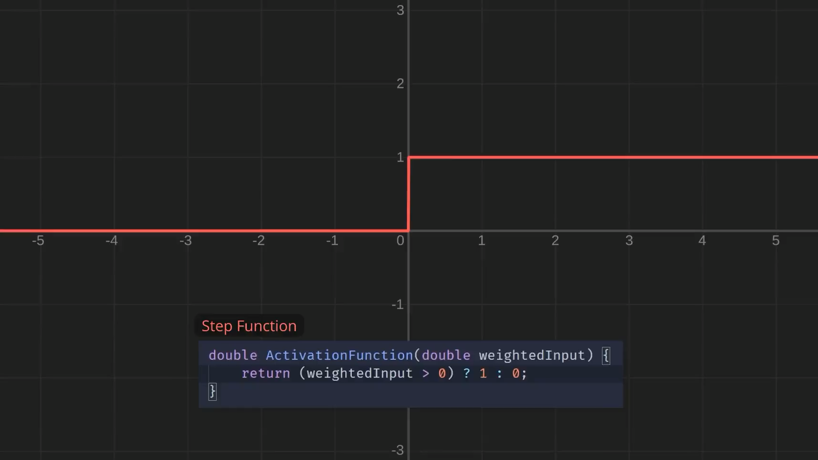
source: youtube.com/c/SebastianLague
Notes:
This is done with better activation functions.
There are many activation functions that are used in machine learning.
The most popular ones are sigmoid and ReLu. (rectified linear unit)
The sigmoid smooths out the activation threshold which results in a much smoother progression and now reflects small changes more accurately.

Slide 19

source: youtube.com/c/SebastianLague
Notes:
However much fun manually adjusting the weights is.
It gets impossible as soon as our network and data grow.
We want the model to learn on its own and determine the weights and biases on its own.

Slide 20
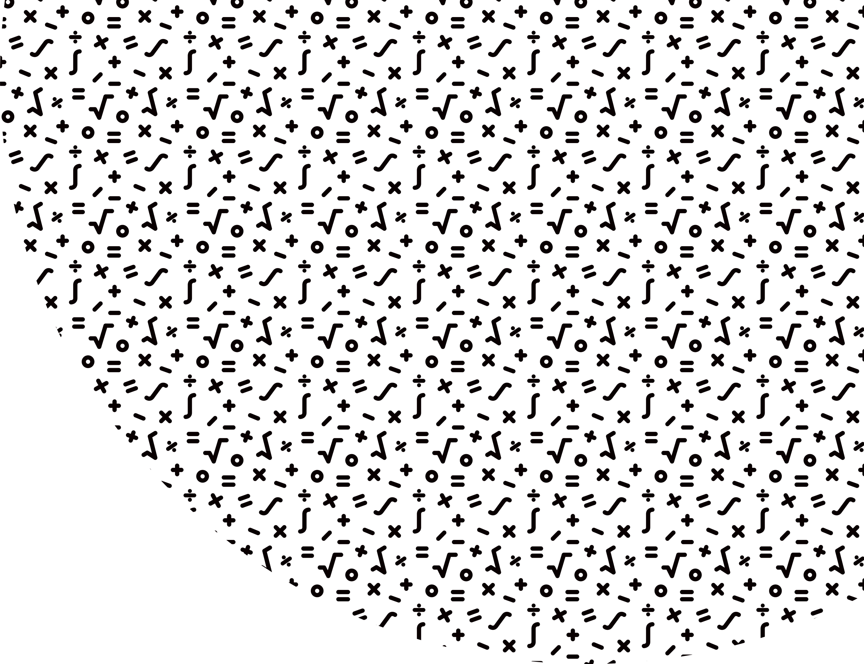
Cost / Loss
error = outputActivation – expectedOutput
error = error * error (emphasize small changes)
Notes:
We can’t just use a brute force approach where we permute all possible combinations and check the results.
The network doesn’t know which results are ideal. There are multiple weight configurations that give the desired output but are far from optimal.
To be able to tell the network which solutions are better than others we calculate the cost or loss of a configuration of weights and biases.
This is simply a calculation of how much the activation for a set of weights and biases differs from the expected output. The expected output is known because that will be our training dataset.

Slide 21
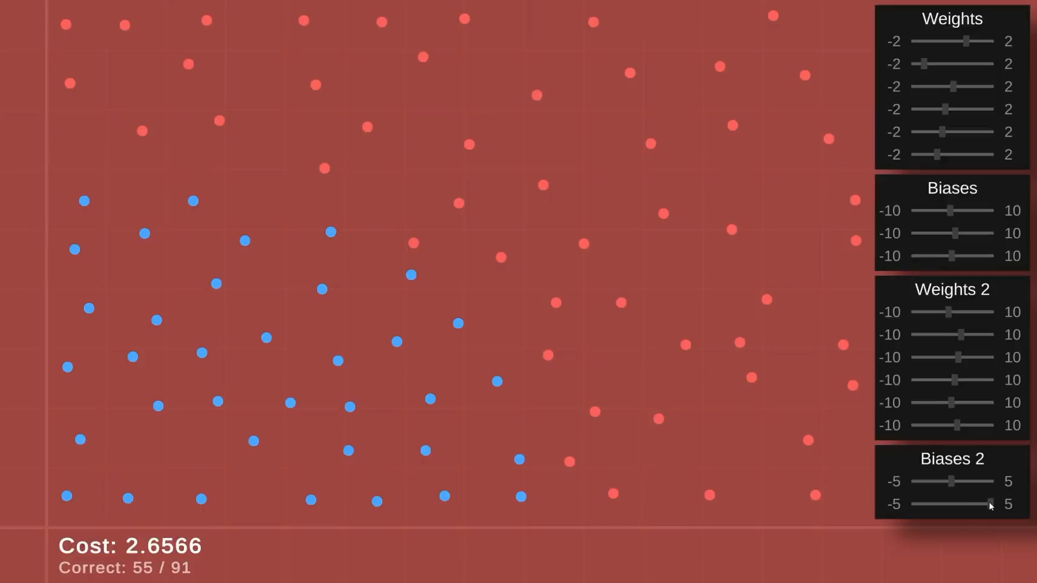
source: youtube.com/c/SebastianLague
Notes:
Now we can see the cost for each configuration of weights and biases and we can also see how many correct guesses we have.

Slide 22
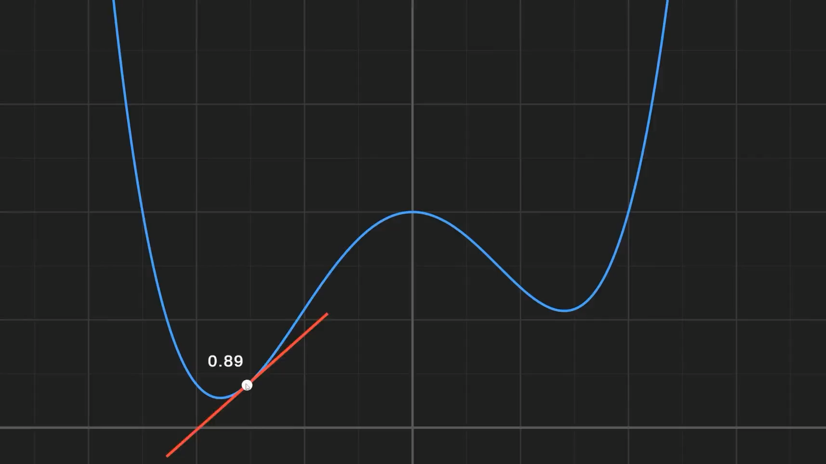
Gradient Descent
source: youtube.com/c/SebastianLague
Notes:
So now we have a way to quantify the quality of our weights and biases.
However, we need an algorithm that finds the best solutions to find the optimal ones.
If we represent the cost as a function of the weights and biases we can imagine the optimal solutions to be the lowest points of our function.
For simple scenarios, we can just calculate the minimums of the function.
However, this becomes very inefficient for more than 2-3 weights. This function represents only one weight.
To find the minimums we can use Gradient Descent.
Using this technique we take a random point on the function.
We then calculate the slope. (derivative)
And move the point in the direction where the slope decreases.
Where the slope is 0 we find a minimum and a desired solution to our function.

Slide 23
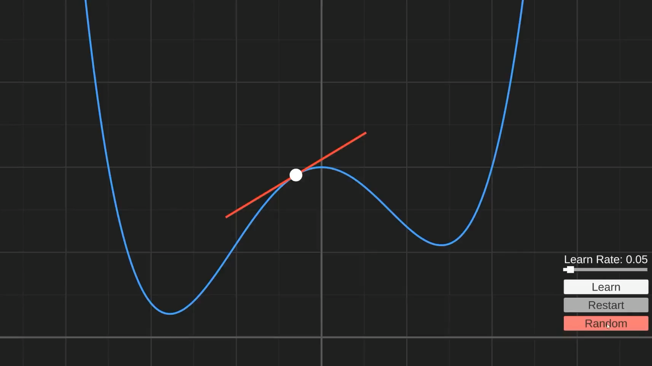
Gradient Descent
source: youtube.com/c/SebastianLague
Notes:
Gradient descent starts with big steps and then takes increasingly smaller steps the closer it gets to the minimum.
The minimum is where the value of our cost function is the lowest.
Once we find that point we can check the value of the weights and biases for that cost and we get our optimal values.

Slide 24

source: youtube.com/c/SebastianLague
Notes:
Now let's see how this looks like for 2 weights.
The cost function will be represented by a slope in 3d space
We want to use gradient descent to reach the lowest point of the slope.
This is then extrapolated to n-dimensional space when n weights and biases are in play.
There are also techniques to avoid getting stuck in local minimums. The most prominent one is stochastic gradient descent.

Slide 25

source: youtube.com/c/SebastianLague
Notes:
Now we are able to let our model learn on its own.

Slide 26
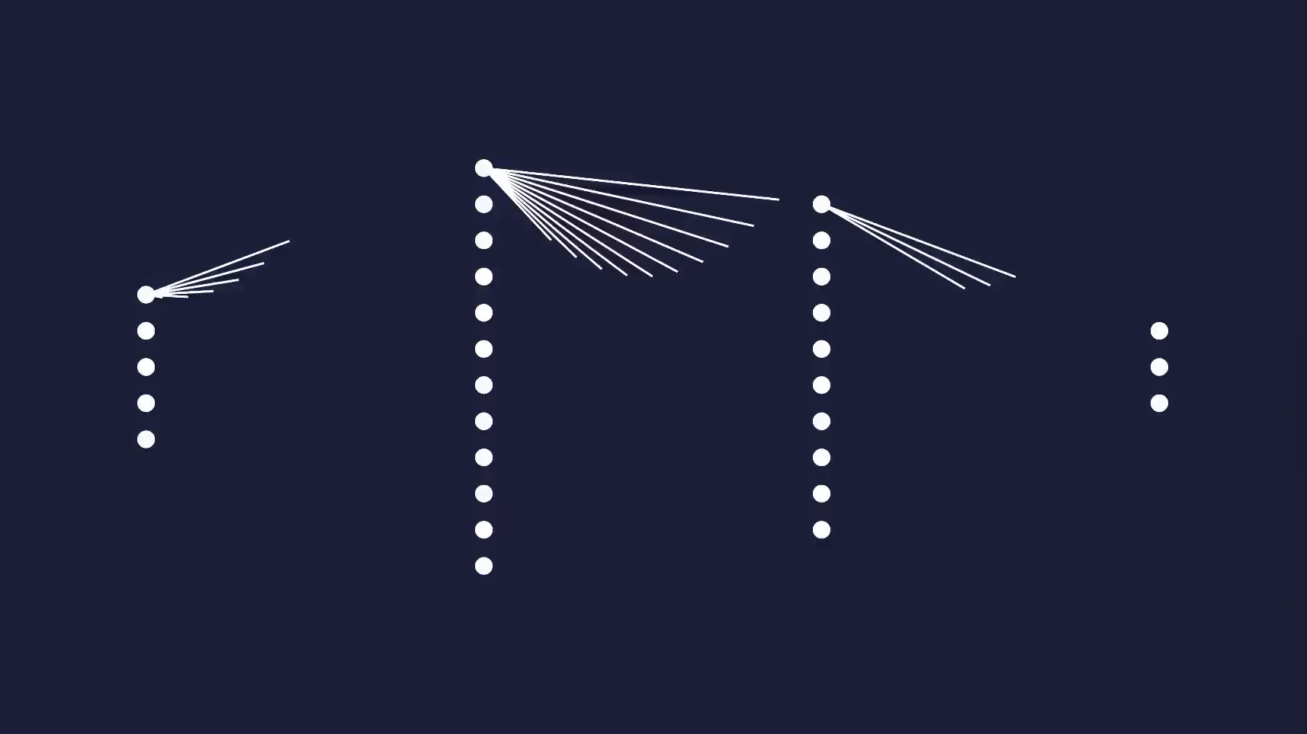
source: youtube.com/c/SebastianLague
Notes:
For big networks, the approach of calculating these for every data point and weight is very inefficient and time-consuming.
That's why techniques have been developed to improve the speed.
One of them is back-propagation.
It works by calculating the gradient of the loss function in respect to all weights. Instead of doing it for each weight individually and by going backwards trough the layers of the network to avoid duplicate calculations.
I won’t get into that here.

Slide 27
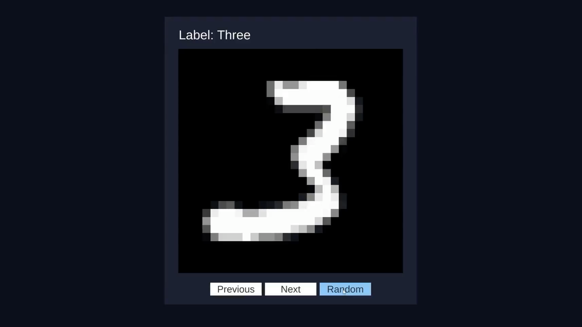
source: youtube.com/c/SebastianLague
Notes:
Now let's scale up our problem to something more realistic
We want to recognize numbers in images.
Let’s see how our input scales and what that means for our neural network.

Slide 28

source: youtube.com/c/SebastianLague

Slide 29
Types of neural networks
Perceptron
Feed Forward Neural Network
Multilayer Perceptron
Convolutional Neural Network
Radial Basis Functional Neural Network
Recurrent Neural Network
LSTM – Long Short-Term Memory
Sequence to Sequence Models
Modular Neural Network

Slide 30
Usages of machine learning
Real-time chatbot agents
Decision support
Customer recommendation engines
Customer churn modeling
Dynamic pricing tactics
Market research and customer segmentation
Fraud detection
Image classification and image recognition
Operational efficiencies
Information extraction
…

Slide 31
Testing machine learning systems?
Ensure that the test data is prepared well and annotated correctly
Agree on target accuracy. No model will be 100% accurate for all inputs
Make sure that the test dataset is a good representation of real data

Slide 32
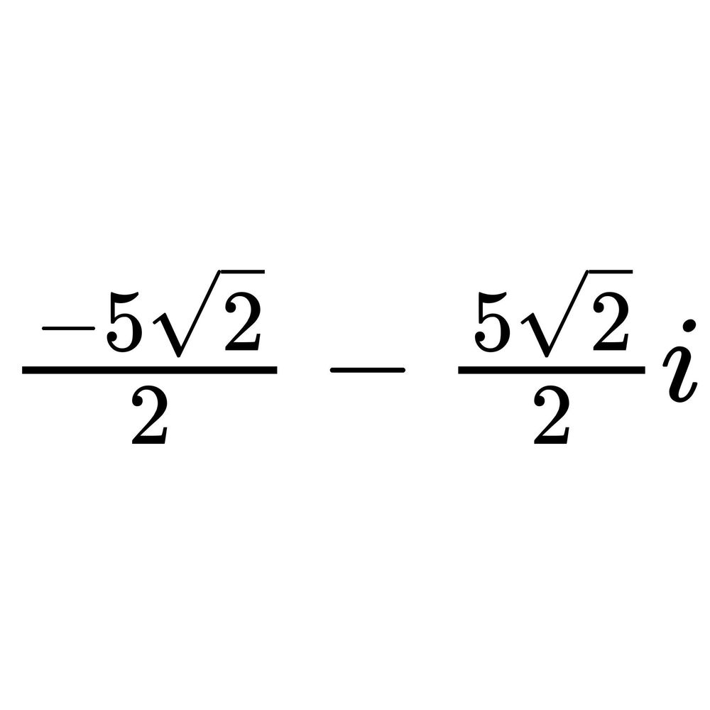
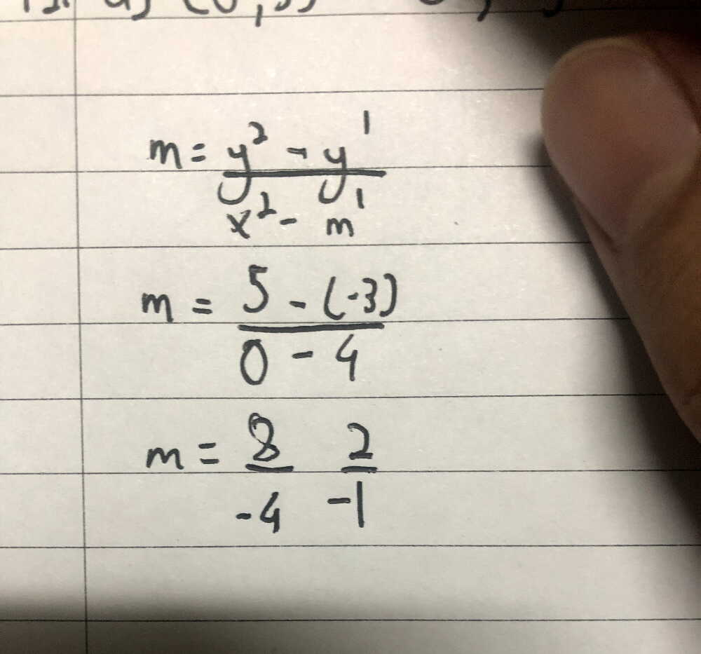
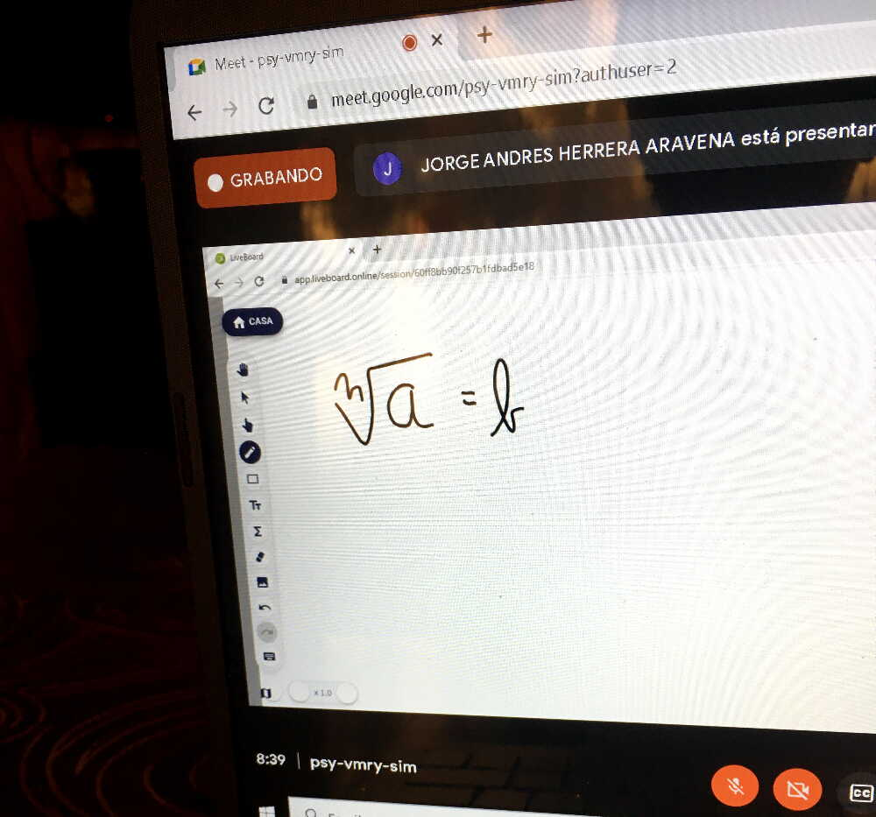
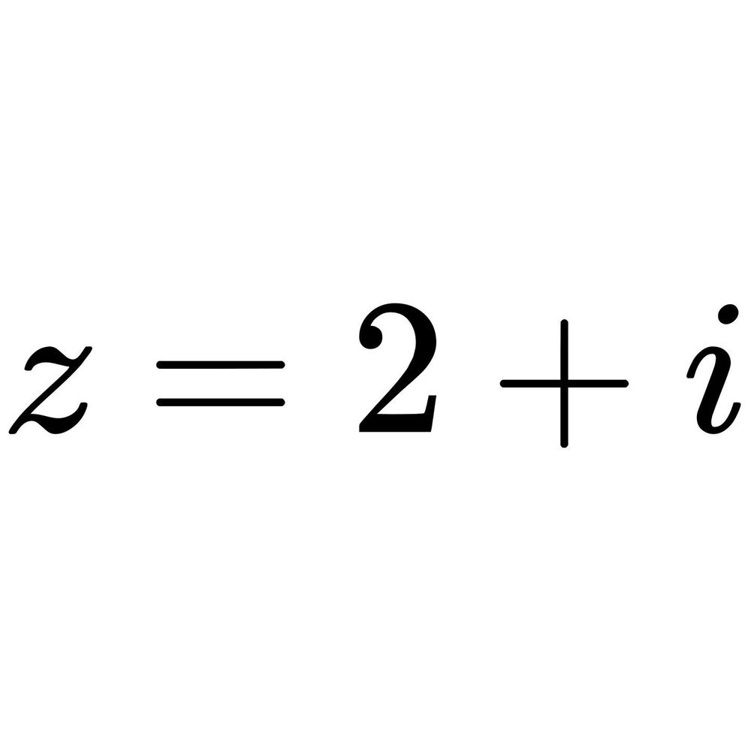
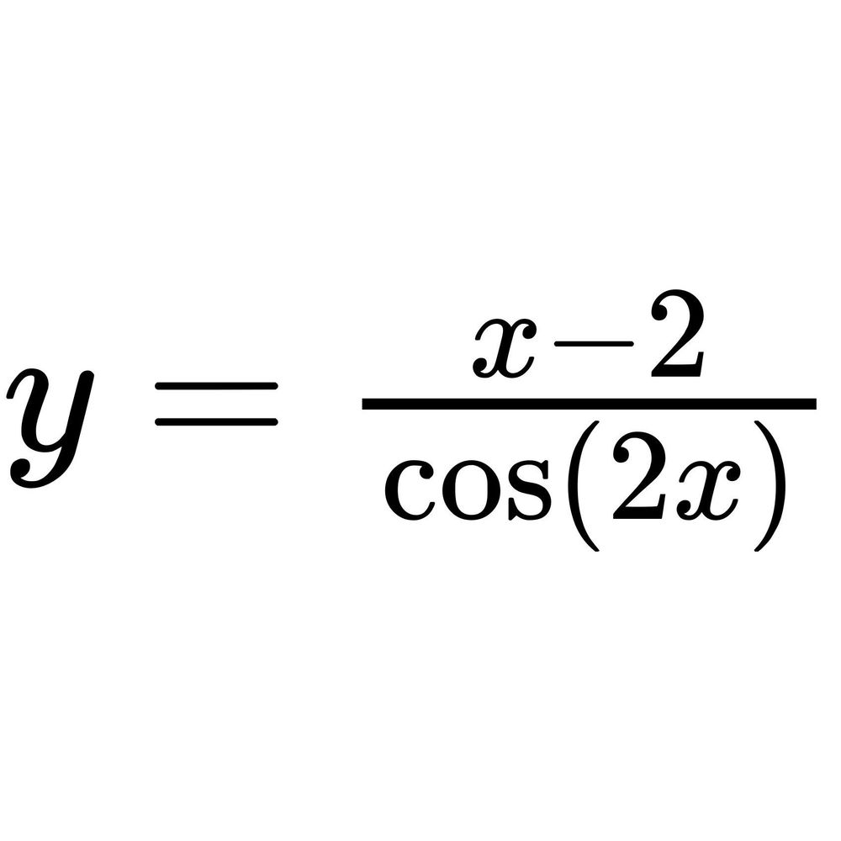
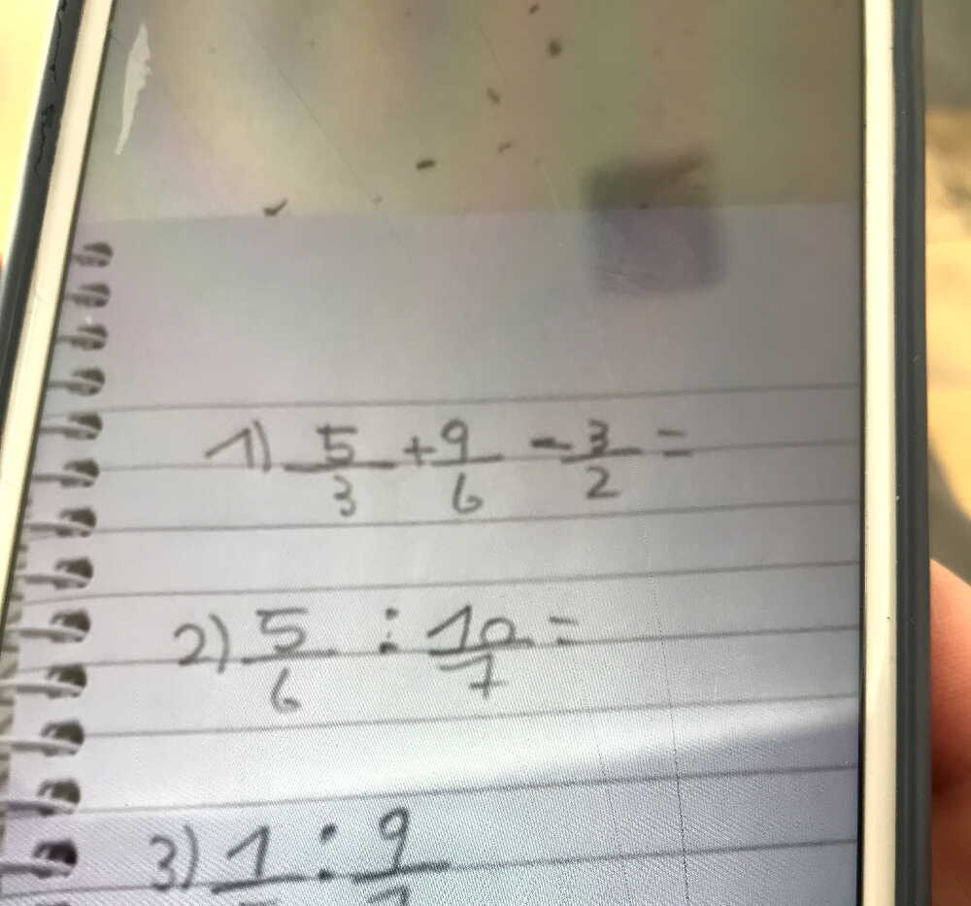
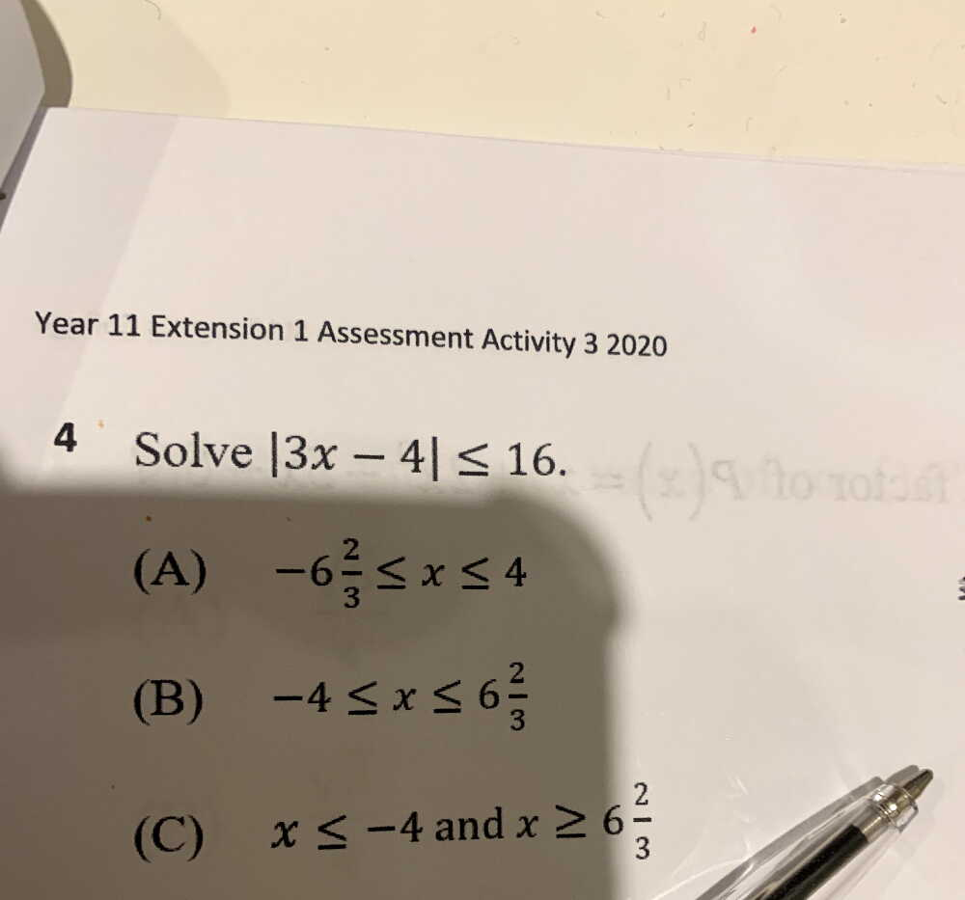
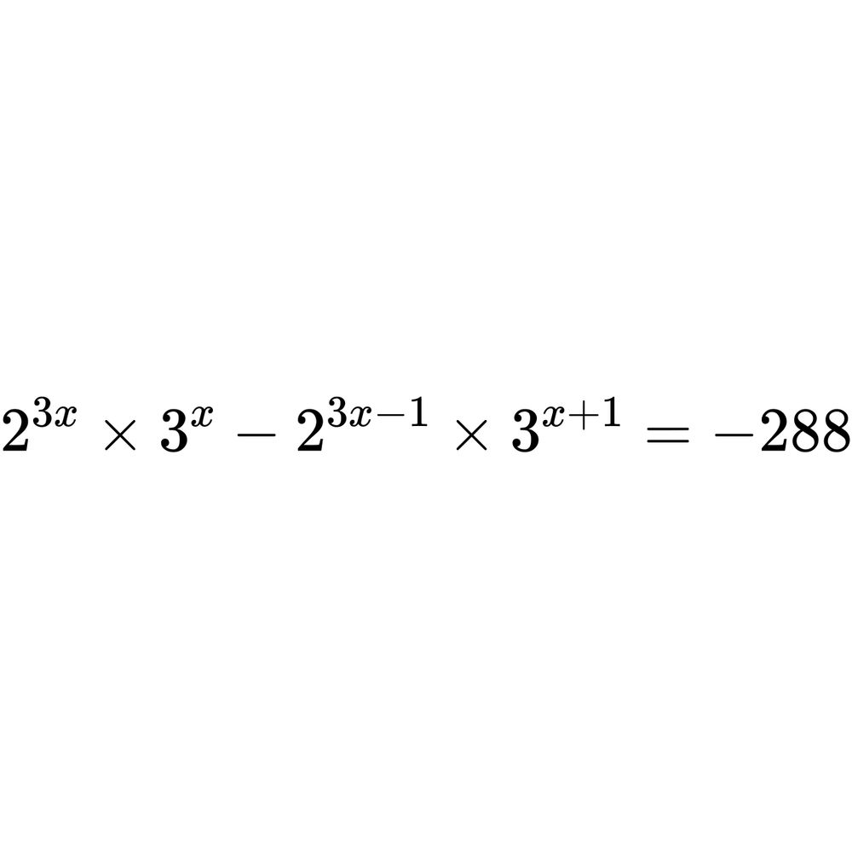
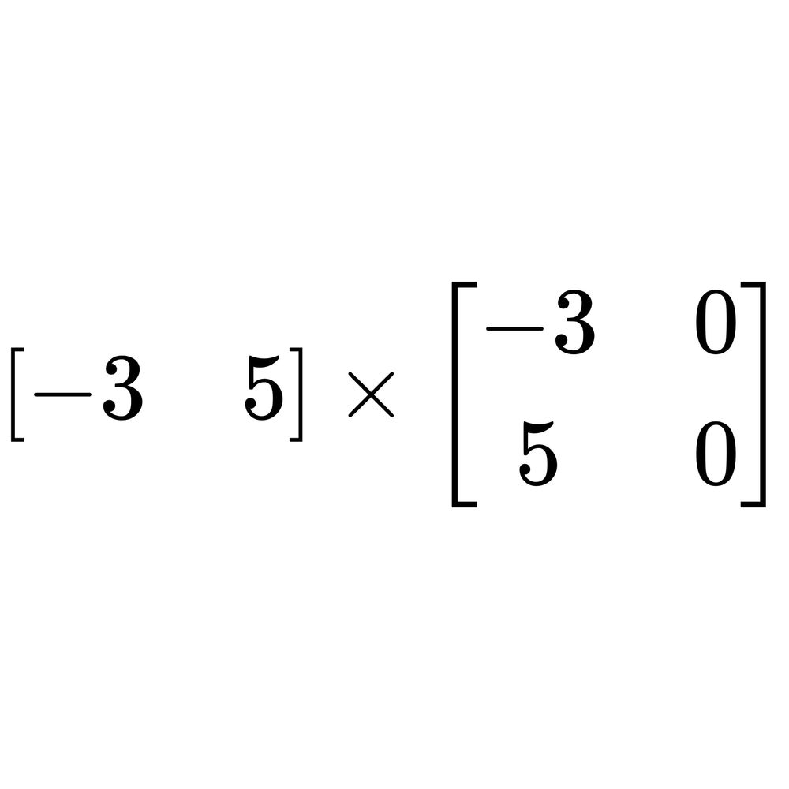
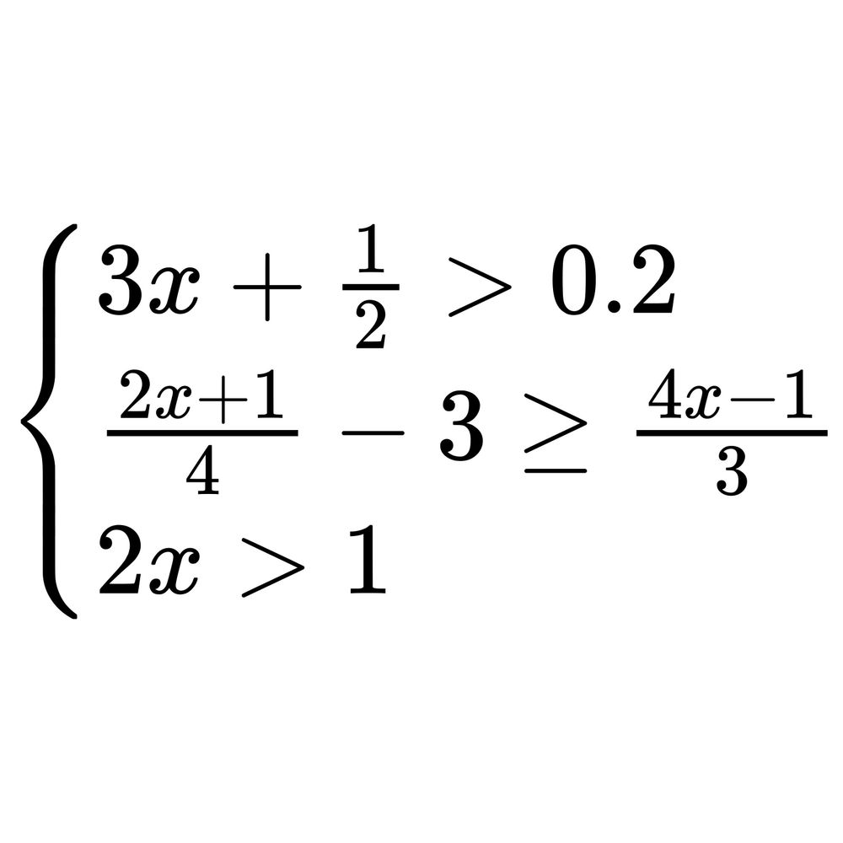
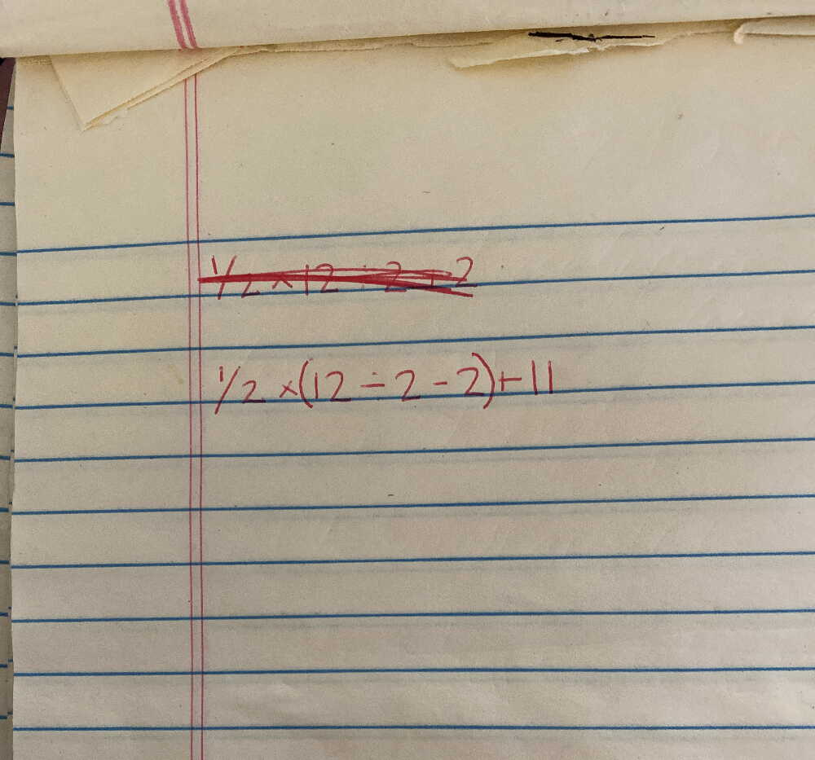
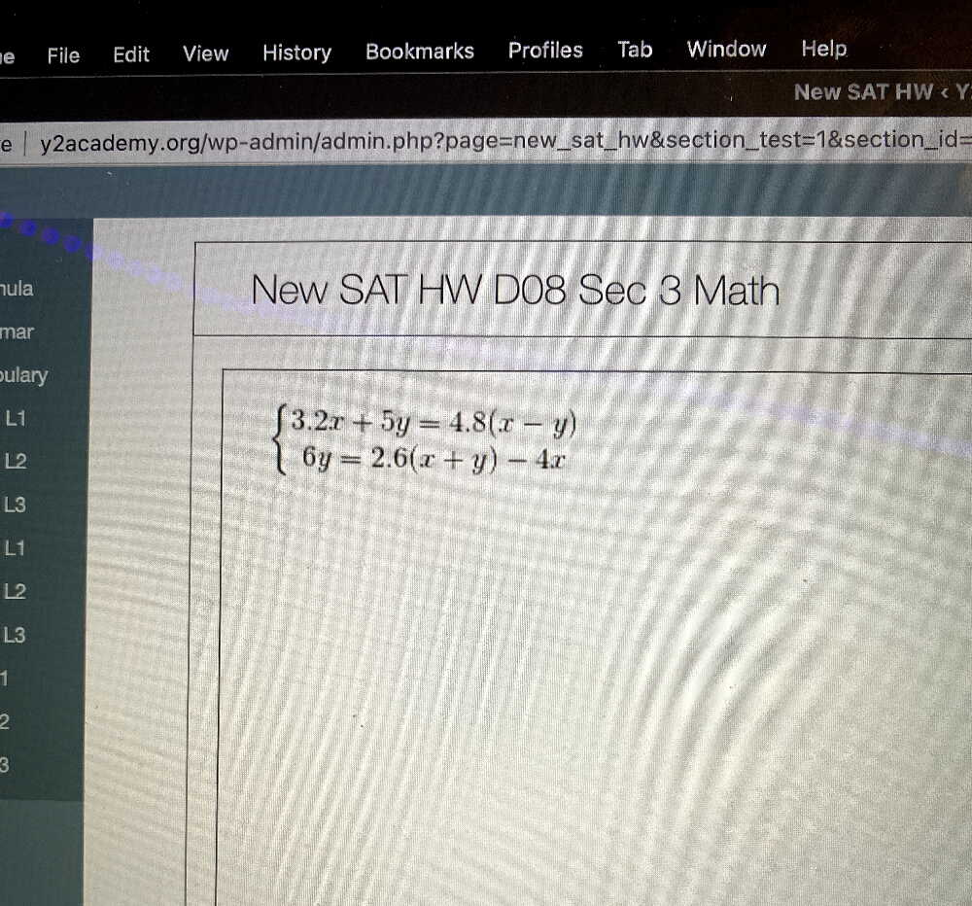
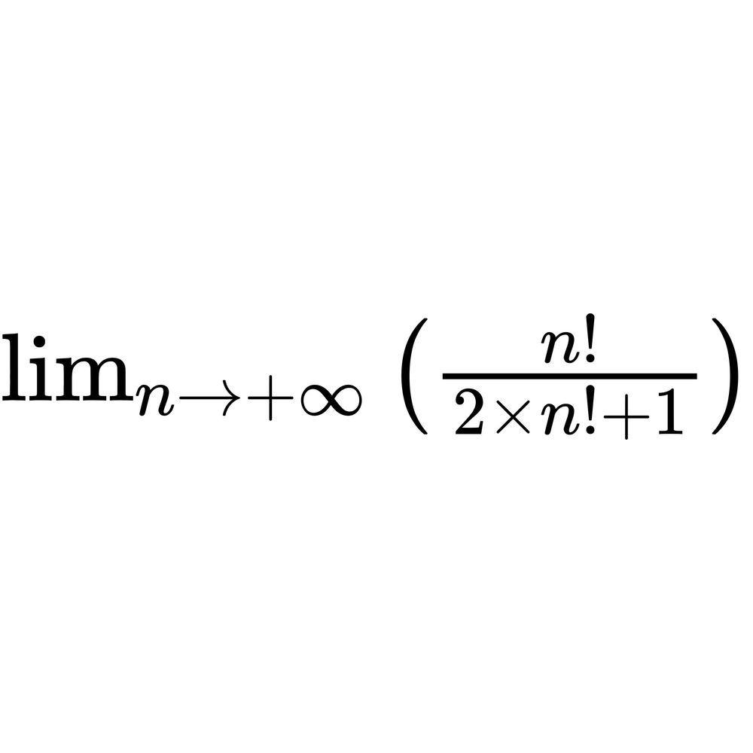

Slide 33
Testing machine learning systems?
Use Data that was not used when training the model (Use data from the training set as a sanity check)
Measure the performance of the system
Track progression from model to model
Have good regression

Slide 34
Q&A!

Slide 35
Credits
Why Neural Networks can learn https://www.youtube.com/watch?v=0QczhVg5HaI
How to Create a Neural Network https://www.youtube.com/watch?v=hfMk-kjRv4c
Back Propagation in Neural Network: Machine Learning Algorithm https://www.guru99.com/backpropogation-neural-network.html
The journey of Gradient Descent — From Local to Global https://medium.com/analytics-vidhya/journey-of-gradient-descent-from-local-to-global-c851eba3d367
Neural Network Playground https://playground.tensorflow.org/
Niko - Github https://github.com/nixpix

